Slide 1
AirClean® PCR Workstations
From Syngene

Slide 2
PCR Workstation
AirClean® Systems AC600 Series Workstations have been designed to create an application solution for the manipulation of and amplification of DNA and RNA

Slide 3
PCR Workstation
Cross-contamination during amplification of DNA and RNA can lead to inaccurate results
Mistakes are costly for both the lab technician’s time and expensive wasted reagents
AirClean® Systems PCR Workstation minimises the potential for cross-contamination saving time and money

Slide 4
PCR Workstation
AirClean® Systems PCR Workstations utilise a rolled polycarbonate design and overlapping parts to ensure no harmful UV radiation escapes
The base, comprised of custom extruded polycarbonate, reflects UV radiation and is chemically resistant for easy cleaning between samples

Slide 5
PCR Workstation
AirClean® Systems PCR Workstations are available in two models:
Combination Workstation
Dead Air Box

Slide 6
UV Light
Both Combination Workstations and Dead Air Boxes have built-in 254 nm ultraviolet light
This allows the operator the capability to irradiate tubes, flasks and pipettes between amplifications

Slide 7
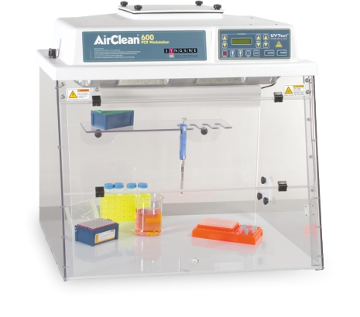
PCR Combination Workstation
AirClean® Systems PCR Combination Workstation uses laminar air to create a positive pressure zone to protect samples from contamination
This environment maximises PCR success by minimising potential DNA contamination

Slide 8
PCR Combination Workstation
Included features:
UVTect™ Microprocessor Controller
ISO 5/Class 100 clean vertical laminar flow
Polycarbonate and polypropylene designed to reflect UV energy
Full access folding sash
Slip hatch

Slide 9
PCR Combination Workstation
Included features:
UV shelf with integral pipette rack
UV timer 0-60 minutes
Lab event timer
Fluorescent light

Slide 10
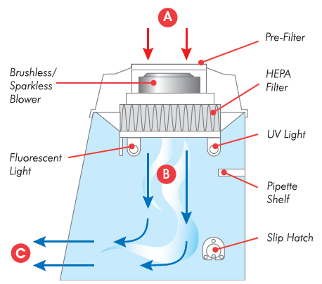
How it works: Combination Workstation
Room air enters at “A” where it is cleaned via electrostatic pre-filtration
Air then moves through the HEPA filter, capturing smaller particulate
Cleaned vertical laminar flow air enters the chamber at “B” and exits at “C”

Slide 11
PCR Combination Workstation
Several size offerings including:
32” W x 24” D
SYN-32PWLF-E
SYN-32PWTLF-E (tall version)
48” W x 24” D
SYN-48PWLF-E
SYN-48PWTLF-E (tall version)

Slide 12
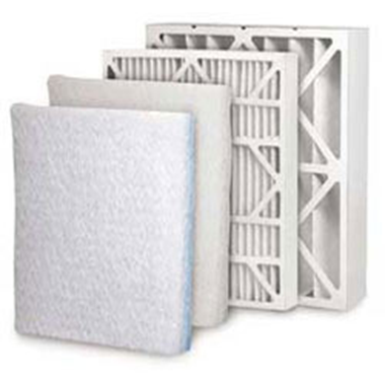
Prefilters
First line of defence- SYN-49FLFPRE, SYN-49FLFPRE7
Captures larger dust/particulate in air
Allows for fewer HEPA replacements
Initial purchase includes prefilter(s)
Most popular PCR consumable

Slide 13
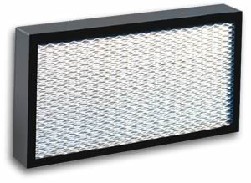
Combination Workstations
H – High
E – Efficiency
P – Particulate
A – Air
Mechanical filter designed to trap particulate
Tested to an efficiency rating to capture particulates of known size
Filter efficiency 99.997% efficient for removal of particulate at 0.3 microns in size

Slide 14
Combination Workstations - HEPA
HEPA filters are designed to trap particulate and can be used in laminar flow or ductless products
HEPA filtration is standard and included in the price of PCR Combination Workstations
ISO 5/Class 100 – less than 100 particles per cubic foot of air
32 “ Filter -SYN-49FHEPA, 48” Filter SYN49FHEPA18

Slide 15
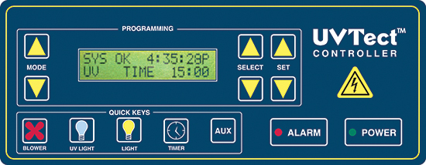
UVTect™ Controller
AirClean® Systems UVTect™ microprocessor controller is standard on all combination workstations and ensures a clean working environment

Slide 16
UVTect™ Controller
Airflow monitoring - UVTect™ constantly monitors pressure drop across HEPA or ULPA filter
Airflow alarms – audible visual alarms alert the operator of low airflow and filter change
Timer – digital timer may be preset by operator and used to time general lab functions

Slide 17
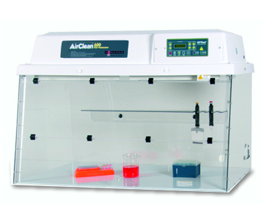
Dead Air Box
AirClean® Systems Dead Air Box provides circulation free environment with UV irradiation. These controlled laboratory environments come with a 0-15 minute mechanical UV timer

Slide 18
Dead Air Box
Included features:
UVTect™ Microprocessor Controller
Polycarbonate and polypropylene designed to reflect UV energy
Full access folding sash
Slip hatch

Slide 19
Dead Air Box
Included features:
UV shelf with integral pipette rack
UV timer 0-60 minutes
Lab event timer
Fluorescent light

Slide 20
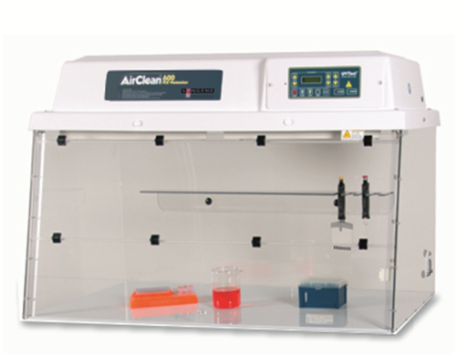
Dead Air Box
Several size offerings including:
32” W x 24” D
SYN-32DBC-E
48” W x 24” D
SYN-48DBC-E
220V AC

Slide 21
Consumables
All PCR Workstations require consumables, here are some common consumables you can market to the customer:
SYN-49AUVBL4 (4) Pack of UV Bulbs
Prefilters – See slide 12
Carts/Stands – SYN-32TRW, SYN-32TRF, SYN-48TRW, SYN-48TRF

Slide 22
Common Enquiries
Can I use this for tissue culture?
Yes – Only if the customer is working with nonhazardous materials, which only require process protection.
No – If the customer is working with hazardous blood borne pathogens, or anything hazardous

Slide 23
Common Enquiries
How long do the _______ last?
Bulbs - the timer is set at 1000 hours (think of car starting)
HEPA filters - Two years, required to use Combination Workstation
Prefilters - (optional) based on visual inspection, average of 1-3 months

Slide 24
Common Enquiries
What sets this PCR workstation apart?
Shipped fully assembled
Arrives ready for use
One-year parts and labour warranty
Made and incorporated in the USA
Microprocessor controls
Robust construction materials

Slide 25
Common Enquiries
Do AirClean® Systems make a biological safety cabinet?
Yes – Class I (updraft HEPA filtered hoods, workstations, and enclosures)
No – Class II No

